Slide 1

8 - <number>

Slide 2
Developing New Products
And Managing the Product Life-Cycle

Slide 3
Lesson Objectives
Explain how companies find and develop new-product ideas.
List and define the steps in the new-product development process and the major considerations in managing this process.
Describe the stages of the product life cycle and how marketing strategies change during the product’s life cycle.
Discuss two additional product and services issues: socially responsible product decisions and international product and services marketing.
Copyright 2011, Pearson Education Inc. Publishing as Prentice-Hall
8 - <number>

Slide 4
First Stop
Google: Innovation Excellence
Google’s Success
Highly Innovative: Google topped Fast Company’s list of the world’s most innovative firms, and regularly ranks within top 3 on other lists.
Market Share: In a competitive market, Google’s core business (online search) market share of 63% is twice the combined share of its two closest competitors.
Ad Revenues: Google captures 70% of all U.S. search-related ad revenues.
How They Did It
Light Speed Innovation: New product planning looks ahead only four to five months; firm strives to take the fastest path to new product development.
Idea Generation: Ideas come from any source or employee. Engineers spend 20% of time developing their own new ideas.
New Product Testing: New applications are launched on Google Labs; users test and provide feedback. Product development is iterative.
Copyright 2011, Pearson Education Inc. Publishing as Prentice-Hall
8 - <number>

Slide 5
New-Product Development Strategy
New product development:
  The development of original products, product improvements, product modifications, and new brands through the firm’s own product development efforts.
New product innovation is very expensive and very risky.
  $20 - $30 billion is lost on failed food products annually.
Copyright 2011, Pearson Education Inc. Publishing as Prentice-Hall
8 - <number>

Slide 6
New-Product Failures
Why do new products fail?
  Overestimation of market size.
  Product design problems.
  Incorrectly positioned, priced, or advertised.
  Pushed by high level executives despite poor marketing research findings.
  Excessive development costs.
  Competitive reaction.
Copyright 2011, Pearson Education Inc. Publishing as Prentice-Hall
8 - <number>

Slide 7
New-Product Development Process
Idea generation
Idea screening
Concept development and testing
Marketing strategy development
Business analysis
Product development
Test marketing
Commercialization
Copyright 2011, Pearson Education Inc. Publishing as Prentice-Hall
8 - <number>

Slide 8
New-Product Development Process
Idea generation:
  Internal sources:
    Company employees at all levels.
  External sources:
    Customers
    Competitors
    Distributors
    Suppliers
    Outsourcing (design firms, product consultancies, online collaborative communities)
Copyright 2011, Pearson Education Inc. Publishing as Prentice-Hall
8 - <number>

Slide 9
New-Product Development Process
Idea screening:
  Process used to spot good ideas and drop poor ones.
  Research provide a description of the product along with estimates of market size, product price, development time and costs, manufacturing costs, and rate of return.
  Evaluated against a set of company criteria for new products.
Copyright 2011, Pearson Education Inc. Publishing as Prentice-Hall
8 - <number>

Slide 10
New-Product Development Process
Concept development and testing:
  Product idea:
    Idea for a possible product that the company can see itself offering to the market.
  Product concept:
    Detailed version of the new-product idea stated in meaningful consumer terms.
  Concept testing:
    Testing new-product concepts with groups of target consumers to find out if the concepts have strong consumer appeal.
Copyright 2011, Pearson Education Inc. Publishing as Prentice-Hall
8 - <number>

Slide 11
New-Product Development Process
Marketing strategy development:
  Part One:
    Describes the target market, planned value proposition, sales, market share, and profit goals.
  Part Two:
    Outlines the product’s planned price, distribution, and marketing budget.
  Part Three:
    Describes the planned long-run sales and profit goals, marketing mix strategy.
Copyright 2011, Pearson Education Inc. Publishing as Prentice-Hall
8 - <number>

Slide 12
New-Product Development Process
Business analysis:
  Involves a review of the sales, costs, and profit projections to assess fit with company objectives.
  If results are positive, project moves to the product development phase.
Copyright 2011, Pearson Education Inc. Publishing as Prentice-Hall
8 - <number>

Slide 13
New-Product Development Process
Product development:
  Develops concept into a physical product.
  Calls for a large jump in investment.
  Prototypes are made.
  Prototypes must have correct physical features and convey psychological characteristics.
  Prototypes are subjected to physical tests.
Copyright 2011, Pearson Education Inc. Publishing as Prentice-Hall
8 - <number>

Slide 14
New-Product Development Process
Testing marketing:
  Product and marketing program are introduced in a more realistic market setting.
  Not needed for all products.
  Can be expensive and time consuming, but better than making a major marketing mistake.
Copyright 2011, Pearson Education Inc. Publishing as Prentice-Hall
8 - <number>

Slide 15
New-Product Development Process
Commercialization:
  Must decide on timing (i.e., when to introduce the product).
  Must decide on where to introduce the product (e.g., single location, state, region, nationally, internationally).
  Must develop a market rollout plan.
Copyright 2011, Pearson Education Inc. Publishing as Prentice-Hall
8 - <number>

Slide 16
Managing New-Product Development
Customer centered new-product development:
  Focuses on finding new ways to solve customer problems and create more customer-satisfying experiences.
Team-based new-product development:
  Various company departments work closely together, overlapping the steps in the product development process to save time and increase effectiveness.
Systematic new-product development:
  Innovation management systems collect, review, evaluate, and manage new-product ideas.
Copyright 2011, Pearson Education Inc. Publishing as Prentice-Hall
8 - <number>

Slide 17
The Product Life Cycle
Product life cycle: The course of a product’s sales and profits in its lifetime. It involves five distinct stages:
  Product development
  Introduction
  Growth
  Maturity
  Decline
Copyright 2011, Pearson Education Inc. Publishing as Prentice-Hall
8 - <number>

Slide 18
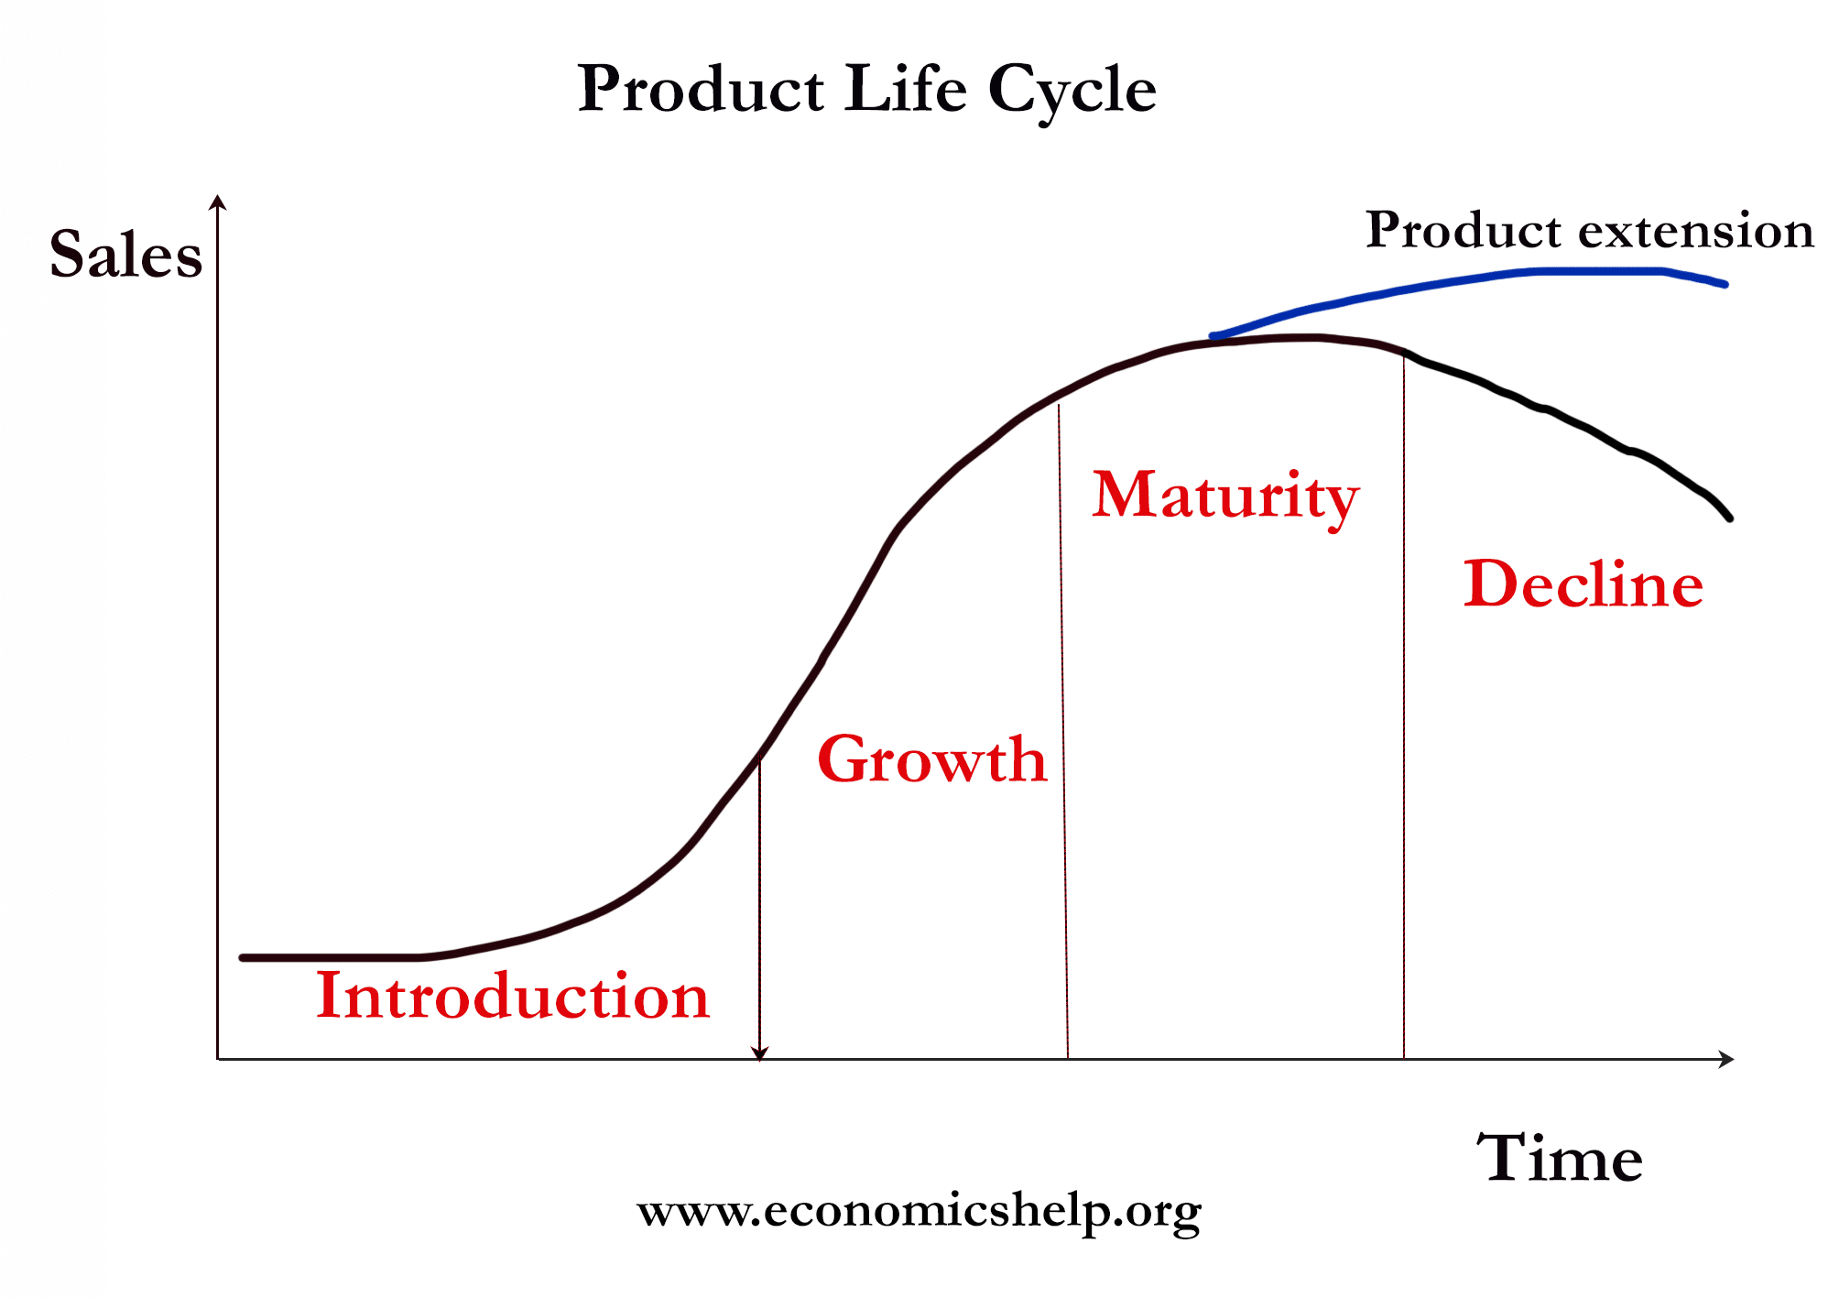
8 - <number>

Slide 19
Practical Problems of PLC
When used carefully, the PLC may help develop good marketing strategies.
However, in practice, it is difficult to:
  Forecast sales level, length of each stage, and shape of PLC.
  Develop marketing strategy because strategy is both a cause and result of the PLC.
Marketers should avoid blindly pushing products to next stage and instead seek ways to rescue products and growth sales.
Copyright 2011, Pearson Education Inc. Publishing as Prentice-Hall
8 - <number>

Slide 20
Introduction Stage of PLC
Sales: Low
Costs: High cost per customer
Profits: Negative or low
Customers: Innovators
Competitors: Few
Marketing objective: Create product awareness and trial.
Copyright 2011, Pearson Education Inc. Publishing as Prentice-Hall
8 - <number>

Slide 21
Introduction Stage of PLC
Marketing strategies:
  Product: Offer a basic product.
  Price: Use cost-plus pricing.
  Place: Build selective distribution.
  Advertising: Build product awareness among early adopters and dealers.
  Promotion: Use heavy promotion to entice product trial.
Copyright 2011, Pearson Education Inc. Publishing as Prentice-Hall
8 - <number>

Slide 22
Growth Stage of PLC
Sales: Rapidly rising
Costs: Average cost per customer
Profits: Rising profits
Customers: Early adopters
Competitors: Growing number
Marketing objective: Maximize market share.
Copyright 2011, Pearson Education Inc. Publishing as Prentice-Hall
8 - <number>

Slide 23
Growth Stage of PLC
Strategies:
  Product: Offer product extensions, service, warranty.
  Price: Price to penetrate the market.
  Place: Build intensive distribution.
  Advertising: Build awareness and interest in the mass market.
  Promotion: Reduce to take advantage of heavy consumer demand.
Copyright 2011, Pearson Education Inc. Publishing as Prentice-Hall
8 - <number>

Slide 24
Maturity Stage of PLC
Sales: Peak sales
Costs: Low cost per customer
Profits: High profits
Customers: Middle majority
Competitors: Stable number beginning to decline
Marketing objective: Maximize profits while defending market share.
Copyright 2011, Pearson Education Inc. Publishing as Prentice-Hall
8 - <number>

Slide 25
Maturity Stage of PLC
Strategies:
  Product: Diversify brand and models.
  Price: Match our best competitors.
  Place: Build more intensive distribution.
  Advertising: Stress brand differences and benefits.
  Promotion: Increase to encourage brand switching.
Copyright 2011, Pearson Education Inc. Publishing as Prentice-Hall
8 - <number>

Slide 26
Maturity Stage of the PLC
Strategies used to manage the PLC during maturity include:
  Modifying the market
  Modifying the product
  Modifying the marketing mix
Copyright 2011, Pearson Education Inc. Publishing as Prentice-Hall
8 - <number>

Slide 27
Maturity Stage of the PLC
Modifying the market:
  Increase the consumption of the current product.
How?
  Look for new users and market segments.
  Reposition the brand to appeal to larger or faster-growing segment.
  Look for ways to increase usage among present customers.
Copyright 2011, Pearson Education Inc. Publishing as Prentice-Hall
8 - <number>

Slide 28
Maturity Stage of the PLC
Modifying the product:
  Changing characteristics such as quality, features, or style to attract new users and to inspire more usage.
How?
  Improve durability, reliability, speed, taste.
  Improve styling and attractiveness.
  Add new features.
Copyright 2011, Pearson Education Inc. Publishing as Prentice-Hall
8 - <number>

Slide 29
Maturity Stage of the PLC
Modifying the marketing mix:
  Improving sales by changing one or more marketing mix elements.
How?
  Cut prices.
  Launch a better ad campaign.
  Move into new market channels.
Copyright 2011, Pearson Education Inc. Publishing as Prentice-Hall
8 - <number>

Slide 30
Decline Stage of PLC
Sales: Declining sales
Costs: Low cost per customer
Profits: Declining profits
Customers: Laggards
Competition: Declining number
Marketing objective: Reduce expenditures and milk the brand.
Copyright 2011, Pearson Education Inc. Publishing as Prentice-Hall
8 - <number>

Slide 31
Decline Stage of PLC
Strategies:
  Product: Phase out weak items.
  Price: Cut price.
  Distribution: Go selective—phase out unprofitable outlets.
  Advertising: Reduce to level needed to retain loyal customers.
  Promotion: Reduce to minimal level.
Copyright 2011, Pearson Education Inc. Publishing as Prentice-Hall
8 - <number>

Slide 32
Additional Considerations
Product decisions and social responsibility:
  Consider public policy issues, regulations regarding acquiring or dropping products, patent protection, product quality and safety, and warranties.
Copyright 2011, Pearson Education Inc. Publishing as Prentice-Hall
8 - <number>

Slide 33
Additional Considerations
International product and service marketing:
  Must determine which products and services to introduce in which countries, and how much to standardize or adapt the offering.
  Packaging presents new challenges for international marketers.
  Many service businesses are global.
Copyright 2011, Pearson Education Inc. Publishing as Prentice-Hall
8 - <number>

Slide 34
Classroom assignment No 01
What are the Producer’s Marketing strategies at various stages in the Product Life Cycle.
  Milk Powder
  Mobile App (Paid)
  Medical Clinic
  Real Estate
Copyright 2011, Pearson Education Inc. Publishing as Prentice-Hall
8 - <number>

